Slide 1
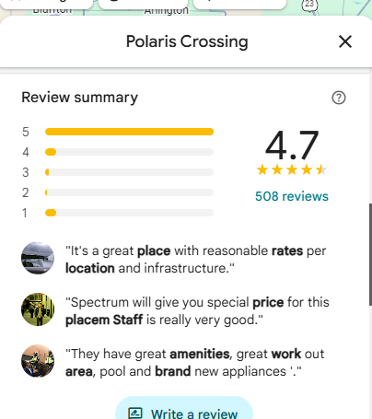
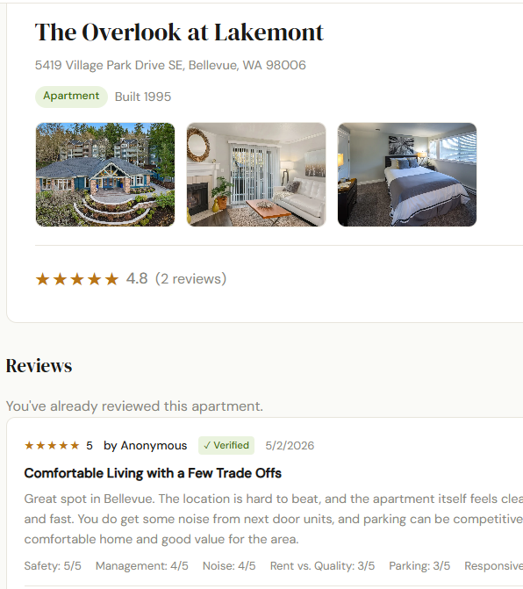
What Makes an Apartment Review Helpful?
Analyzing 150,177 Google Reviews
By Gael Mbala
MSIS 415 | May 7, 2026

Slide 2
Data Source & Cleaning
Source: Google Maps Review Dataset (2021)
Raw dataset: millions of records across all business types
After filtering to apartments/residential: 150,177 reviews
Date range: June 2007 – September 2021

Slide 3
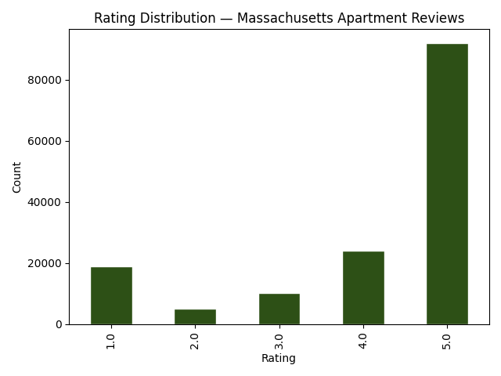
Descriptive Analysis
Average rating: 4.10
Rating distribution chart
Average review length: 148 characters
Reviews with business response: 36,882 (24.6%)

Slide 4
Feature Engineering
Problem: no helpfulness votes in this dataset
Solution: engineer a proxy score (0-5) from 5 signals
Table:
Signal | Logic
Review length | word count >= 50 = 1pt
Has photos | pics attached = 1pt
Recency | posted within last year = 1pt
Business response | landlord replied = 1pt
Rating extremity | 1 or 5 stars = 1pt

Slide 5
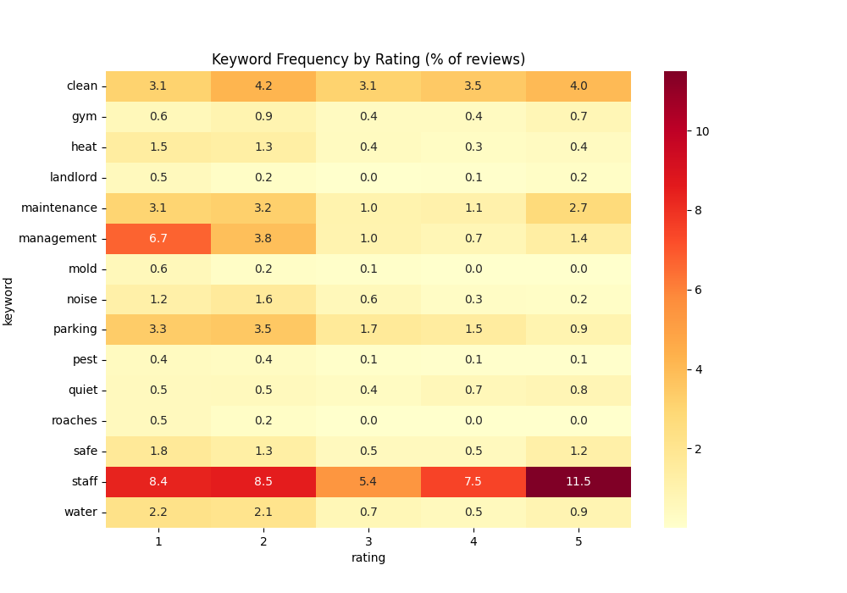
Text Mining: Topic Heatmap
% of reviews mentioning each keyword, by star rating

Slide 6
Regression Analysis
Result table
Goal: predict whether a review is helpful (score ≥ = helpful
Model: Logistic (scikit-learn)
80/20 train/test split → 120,141 training, 30,036 test reviews
 | Precision | Recall | F1
Not Helpful | 0.99 | 1.00 | 0.99
Helpful | 1.00 | 0.98 | 0.99
Accuracy |  |  | 99%

Slide 7
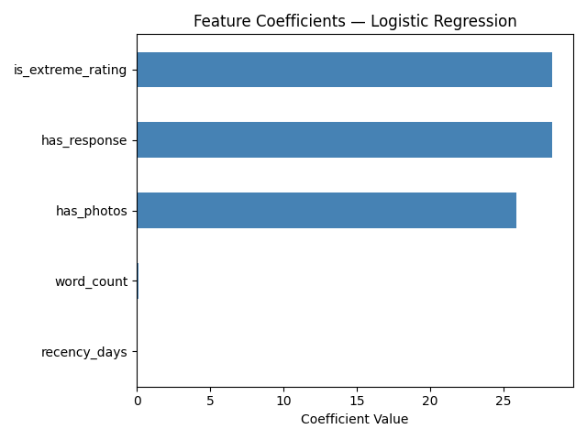
Key Finding: Feature Coefficients

Slide 8

Conclusion
4 analysis types completed: Descriptive, Feature Engineering, Text Mining, & Regression
Key takeaways:
Most reviews are moderately helpful (score 2-3)
Roaches, mold, and management are clear 1-star signals
Business engagement predicts helpfulness more than review length
99% model accuracy on held-out test set
Real-world application: RentWise review scoring rubric

Slide 9
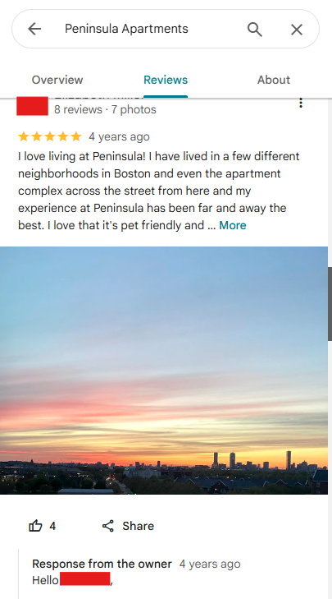
Questions?
Gael Mbala
Gael.mbala001@umb.edu

